Slide 1
FY26 Budget Feedback Meeting

Slide 2
AGENDA
Action Items
Approval of Agenda
  Approval of Previous Minutes
Discussion Items
  Budget Development Presentation
    ACTION ITEM: GO Team vote on Draft Budget
Information Items
Principal’s Report
  Committee Reports – School Uniform Committee
Announcements

Slide 3
Meeting Norms
This is a meeting of the GO Team. Only members of the team may participate in the discussion. Any members of the public present are here to quietly observe.
We will follow the agenda as noticed to the public and stay on task.
We invite and welcome contributions of every member and listen to each other.
We will respect all ideas and assume good intentions.

Slide 4
Budget Feedback presentation & Discussion

Slide 5

GO Team Budget Development Process
YOUR SCHOOL STRATEGIC PLAN…
is your roadmap and your role.
It is your direction, your priorities, your vision, your present, your future.
Step 1: Data Review
Step 2: Strategic Plan Review
Step 3: Budget Parameters
(Strategic Priorities)
Step 4: Budget Choices

Slide 6

Overview of FY26 GO Team Budget Process
Step 2 Principals Workshop FY 26 Budget
January 15
Step 4 Principals Cluster Supt. Discussions
Step 1 Update Strategic Plan & Rank Priorities
Step 7 Principals HR Staffing Conferences Begin
Feb. 24-27
Step 3 GO Team Initial Budget Session
January 15-31
Step 8* GO Team Final Budget Approval Meeting
Budgets Approved by March 14
Step 6 Cluster Supt. Review February 17-21
Step 5* GO Team Feedback Mtg. February 10-14
GO Teams are encouraged to have ongoing conversations
* GO Teams will need to take ACTION on the budget at these meetings.

Slide 7
Budget Feedback Meeting
What
During the GO Team Feedback meeting the principal will share the 25-26 Strategic Plan Breakout, provide an overview of the school’s draft budget, share updated tabs from the Excel template, and review/collaborate with the GO Team on the comments/notes to explain the use of school-level flexibility in budget allocations.
Why
This meeting provides an opportunity for GO Teams to discuss the principal’s proposed budget and how it supports the school's programmatic needs and key strategic priorities for the 25-26 school year. It also provides the GO Team the opportunity to review and provide feedback on proposed use of school-level flexibility.
When
Early February 10 - February 14th, before Cluster Superintendent review.

Slide 8
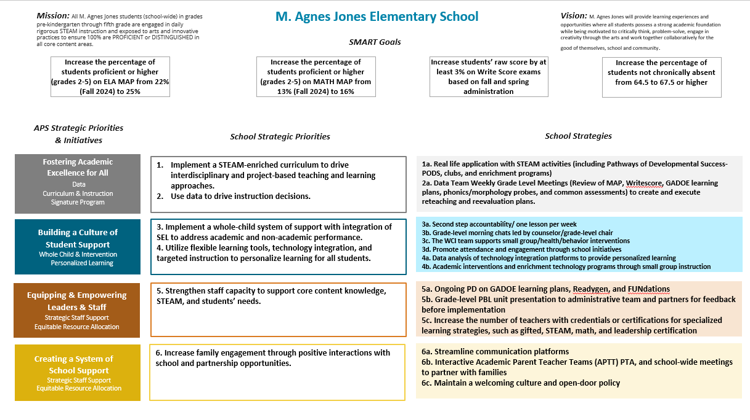
M. Agnes Jones Strategic Plan

Slide 9
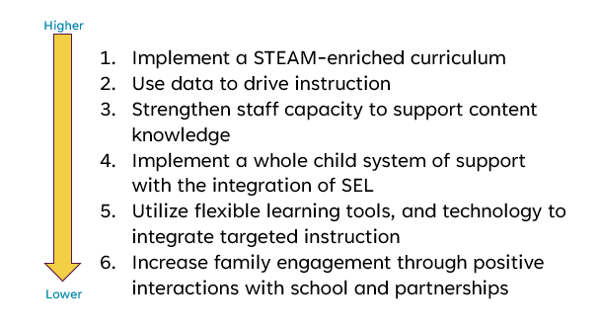
M. Agnes Jones
Strategic Plan
Priority Ranking
Insert the school’s ranked priorities from High to Low

Slide 10
FY 26 Budget Parameters
FY26 Ranked School Priorities | Rationale
Implement a STEAM-enriched curriculum | As the first GaDOE-certified school to adopt a STEAM-enriched curriculum, we lead in fostering creativity, critical thinking, and real-world problem-solving. This interdisciplinary approach prepares students for success in a rapidly evolving world while positioning our school as a leader in innovative education.
Use data to drive instruction | Data talks are essential for maximizing instruction and meeting the diverse needs of our students. By analyzing student data collaboratively, we can identify strengths, address gaps, and tailor instruction to each learner’s needs.
Strengthen staff capacity to support content knowledge | Strengthening our staff is vital, as 34% have three years or less of experience, and we are navigating the rollout of new ELA standards while continuing to refine our math plans. Targeted professional development and support will ensure all teachers feel confident and prepared to deliver high-quality instruction, fostering consistency and excellence in student learning.

Slide 11
FY 26 Budget Parameters
FY26 School Priorities | Rationale
Implement a whole child system of support with the integration of SEL | Focusing on social-emotional learning (SEL) and the whole child is essential for fostering academic success and well-being.
Utilize flexible learning tools, and technology to integrate targeted instruction | Flexible learning tools and technology are crucial for supporting small group instruction by enabling personalized learning and targeted support. These resources help teachers address diverse student needs, track progress efficiently, and provide engaging, adaptive experiences that foster academic growth and equity in the classroom.
Increase family engagement through positive interactions with school and partnerships | When families are actively involved, students benefit from increased support, improved academic performance, and enhanced social-emotional well-being. Engaged families strengthen the school community, creating a collaborative environment that empowers every child to thrive.

Slide 12
Review of FY26 Signature and Turnaround Program Funding Process
Overview
* The district is piloting a zero-based budgeting (ZBB) process for Signature and Turnaround Program Funds this year.
* Zero-based budgeting (ZBB) is a budgeting process that allocates funding based on program efficiency and necessity rather than budget history. As opposed to traditional budgeting, no item is automatically included in the next budget.
* As such the initial allocation for these programs at all schools will be $0.
Process
* Principals will develop proposed requests for the personnel and non-personnel they need to support the Signature and/or Turnaround Programs at their schools.
* Principals will share and discuss their proposals and rationale for the proposals with their school GO Team for feedback.
* After discussing with their GO Team, principals will submit their request for review by January 31st. Funding for these programs will be provided the week of February 3rd.

Slide 13
Overview of Approved Signature Program Funds

Slide 14
Signature program funds requested vs. approved
Requested Signature Program Funds: $719,232
-(2) Signature STEAM Program Coaches- Curriculum Development, Certification, Classroom Coaching, Professional Development -(1) Signature Program Spanish Teacher -(2) Signature Program STEAM Teachers -$20,000 for materials and supplies
APPROVED Signature Program Funds: $205,232
Staffing: -(1) Signature Program STEAM Lab Teacher -(.25) Signature Program Spanish Teacher -(.5) Master Teacher Leader (School will cover the additional costs) Non-Staffing: $15,000 allocated for Signature Program materials and supplies

Slide 15
M. Agnes Jones Es
FY26 Summary of Proposed Staffing AND Non-Staffing
-

Slide 16
Summary Tab Overview
The Summary Tab provides a summary of the staff in our school. The columns show how many positions are:
Earned – positions allocated by district departments. There is no school-level flexibility with these positions.
Funded – District’s recommended staffing for positions where there is school-level flexibility with staffing the position.
Staffed – This shows how the principal plans to staff the position for the FY26 school year.
Difference—This shows the difference between the recommendation from the District and the Principal's proposed FY26 staffing plan.
Comments: The principal must provide comments if there is a difference in what is Funded and Staffed. Principals and GO Teams will discuss the rationale provided for the Comments section.
Position Title | Earned | Funded | Staffed | Dif | Comments
Teachers
Middle School Core |  | 49.50 | - | (49.50)
Middle Electives |  | 19.00 | - | (19.00)
Teacher Math 6-8 |  |  | 11.00 | 11.00
Teacher Science 6-8 |  |  | 10.00 | 10.00
Teacher Social Studies 6-8 |  |  | 10.00 | 10.00
Teacher ELA 6-8 |  |  | 9.00 | 9.00
Teacher Art 6-8 |  |  | 2.00 | 2.00
Teacher Band 6-8 |  |  | 1.00 | 1.00
Teacher Music 6-8 |  |  | 2.00 | 2.00
Teacher Orchestra 6-8 |  |  | 1.00 | 1.00
Teacher Physical Ed 6-8 |  |  | 7.00 | 7.00
Teacher Performing Arts 6-8 |  |  | 2.00 | 2.00
Teacher World Language 6-8 |  |  | 12.00 | 12.00
Teacher Gifted |  | 13.00 | 11.00 | (2.00)
Teacher Social Emotional Learning |  |  | - | -
EIP TEACHERS |  | 3.50 | 5.00 | 1.50
Teacher REP 6-12 |  |  | 5.00 | 5.00
Example

Slide 17
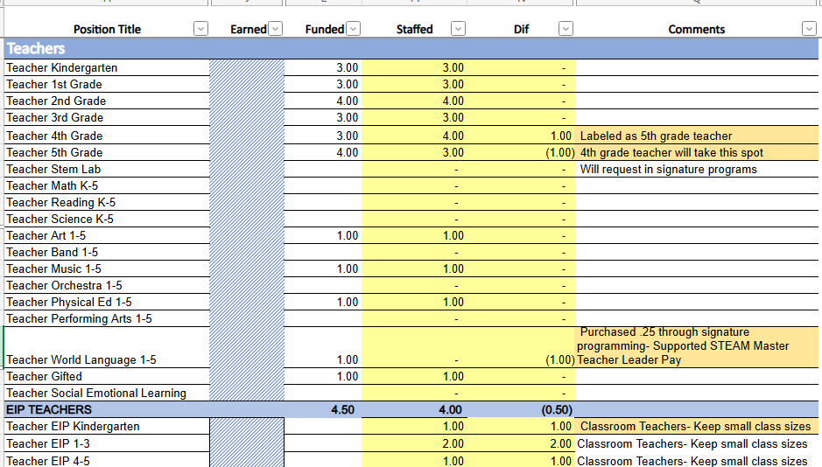

Slide 18
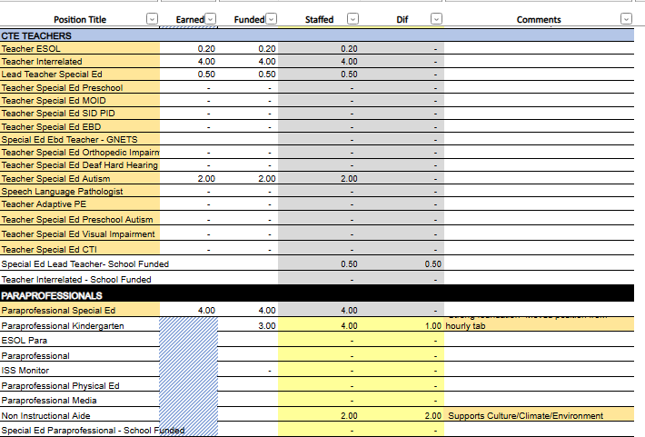

Slide 19
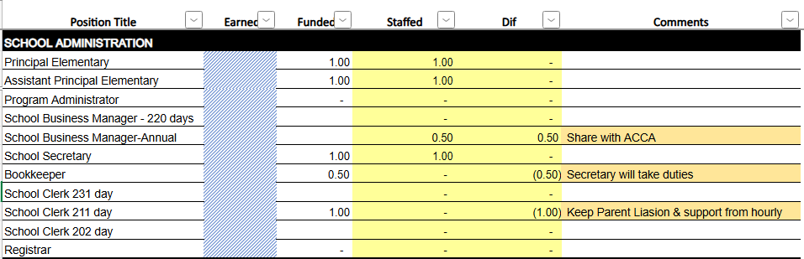

Slide 20
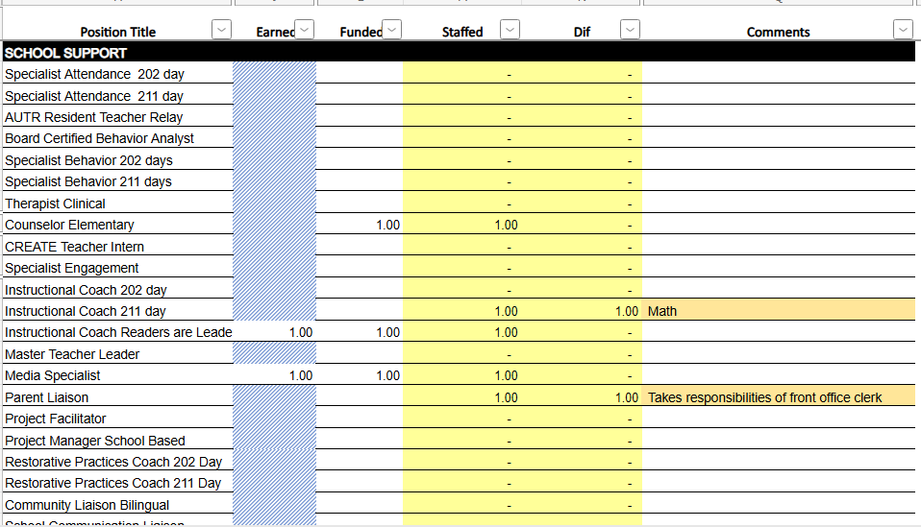

Slide 21
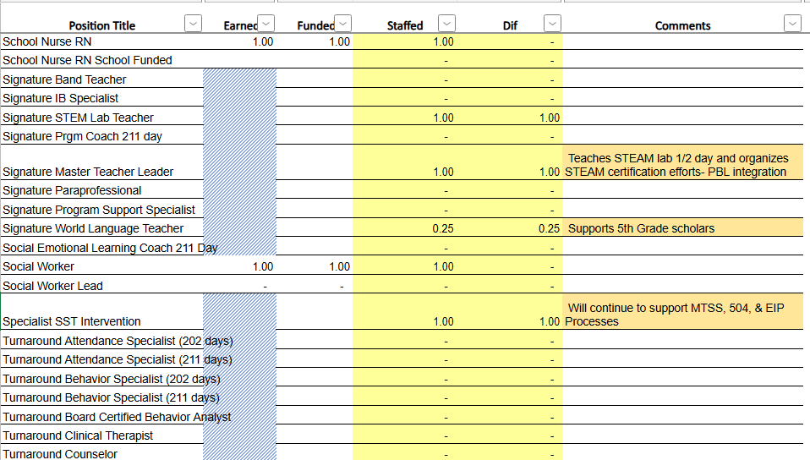

Slide 22
Summary of position Changes to Support the fy26 bUDGET
CREATED | REMOVED
(1) Kindergarten Paraprofessional | (1) Non-Instructional Paraprofessional
(1) Signature Program STEAM Teacher (1) Signature Program Master Teacher Leader | (2) STEAM Lab Teachers (1) Abolished & (1) moved to Signature Program STEAM Teacher
(2) Hourly Teacher Tutors | .5 Communications Liaison
(2) Hourly Security Aides | (1) School Clerk
.25 Signature Spanish Teacher | (1) Interrelated Teacher (Not Earned)
.10 ESOL Teacher (to address deficit) | (1) Assistant Principal
 | (1) Instructional Coach

Slide 23
Non-Staffing Tab Overview
The Non-Staffing Tab shows how funds are allocated for non-staff items in the school. There is school-level flexibility for most of these items. The tab has columns for:
Recommended—District’s recommended amount to spend on the line item.
Allocation – This shows how much the principal is proposing to allocate towards the line item in FY26.
Difference—This shows the difference between the recommended amount and the allocation.
Notes: The principal must provide comments if there is a difference in what is Recommended and what is Allocated. Principals and GO Teams will discuss the rationale for the notes section.
Description | Rec. | Allocation | Diff | Notes
Reserve | $ 291,149 | $ 291,149 | $ -
Teacher Stipends |  |  | $ -
Secretary Overtime |  |  | $ -
Contracted Services for Instruction |  |  | $ -
Contracted Services for Professional Development |  |  | $ -
Web-based Subscriptions and Licenses |  |  | $ -
Signature Program Communication/Shipping Fee |  |  | $ -
Computer Software |  | $ - | $ -
Mileage |  |  | $ -
Student Transportation-APS Buses |  |  | $ -
District Funded Field Trips | $ 60,886 | $ 60,886 | $ -
Teaching/Other Supplies | $ 81,900 |  | $ (81,900)
Signature Program Supplies |  |  | $ -
Computer Equipment |  |  | $ -
Media Supplies | $ 13,104 |  | $ (13,104)
Example

Slide 24
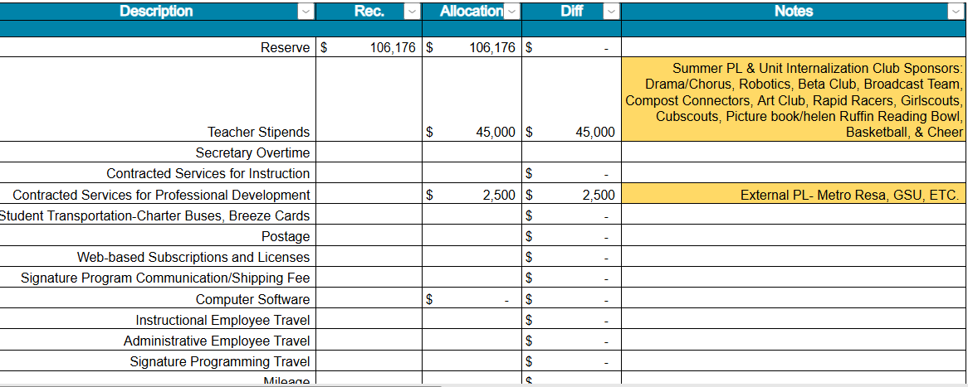

Slide 25
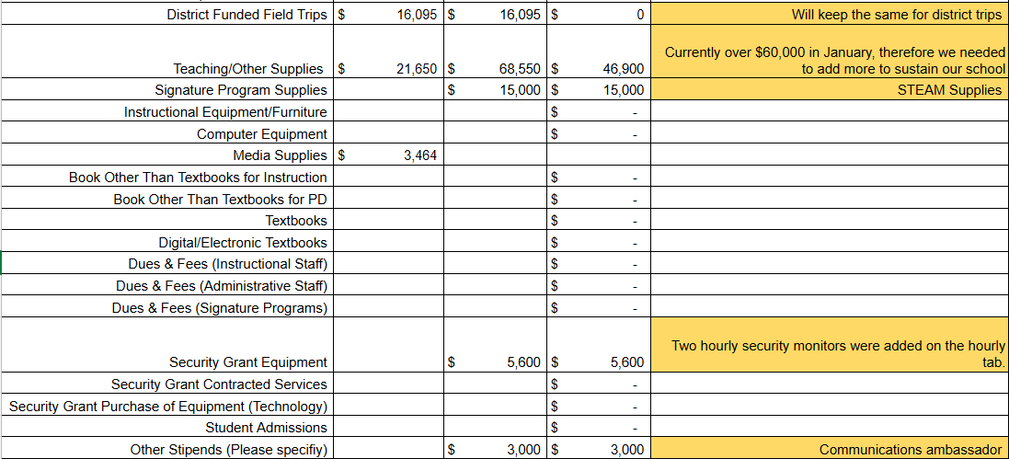
Non-Staffing Tab Continued

Slide 26
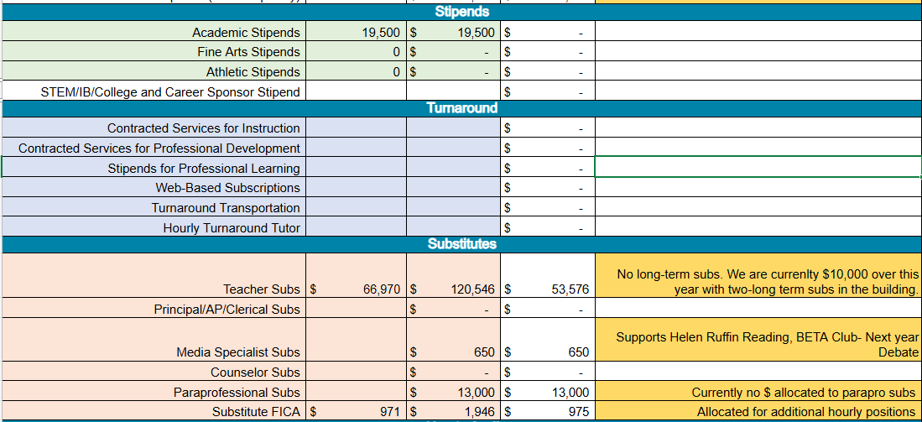
Non-Staffing Tab Continued

Slide 27
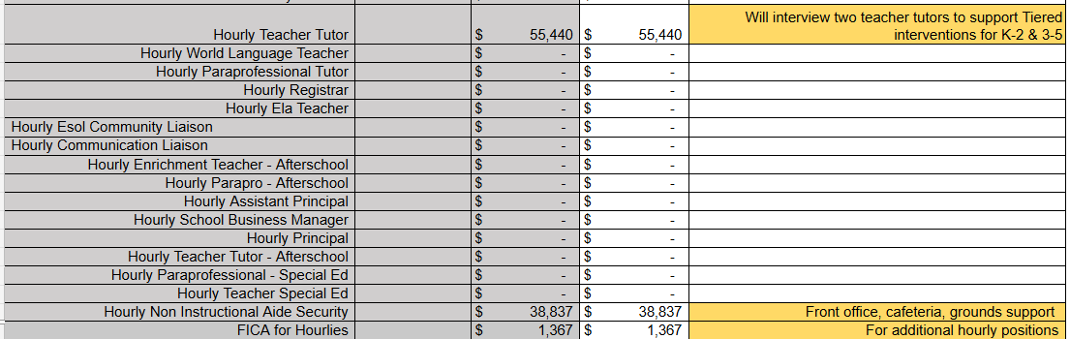
Non-Staffing Tab Continued

Slide 28
Descriptions of Strategic Plan
Breakout Categories
Priorities: FY25 funding priorities from the school’s strategic plan, ranked by the order of importance.
Strategies: Lays out specific objectives for school’s improvement.
Request: “The Ask” What needs to be funded in order to support the strategy?
Amount: What is the cost associated with the Request?

Slide 29
FY26 Strategic Plan Break-out
Priorities | Strategies | Requests | Amount
Implement a STEAM-Enriched Curriculum | Provide opportunities for students and staff to engage in hands-on problem-based learning | STEAM Lab Teacher (K-5) (1) Signature Program Master Teacher Leader (3-5) | $255,112
Implement a STEAM-Enriched Curriculum | Hands-on opportunities with aquaponics and agriculture | Supplies & Materials | $15,000
Data Driven Strengthen Staff Capacity to Build Content Knowledge | Professional Learning Communities/Data driven focus– Focus on new ELA standards/SoR Math Coach | Keep an IC in the RAL position (Paid by District) School pays for Math Coach | $313,996
Implement a school-wide system of support with the integration of SEL | Second Step, Check & Connects, School-wide behavior/attendance supports | Counselor Social Worker (2) non-instructional Paraprofessionals | $410,673
Use Flexible learning tools & technology to target instruction | Targeted interventions/SST/EIP Tiered Support | Keep SST interventionist for EIP/MTSS and to support WCI (2) Teacher Tutors | $55,440
Increase family engagement | APTT | Keep Parent Liaison | $57,496

Slide 30
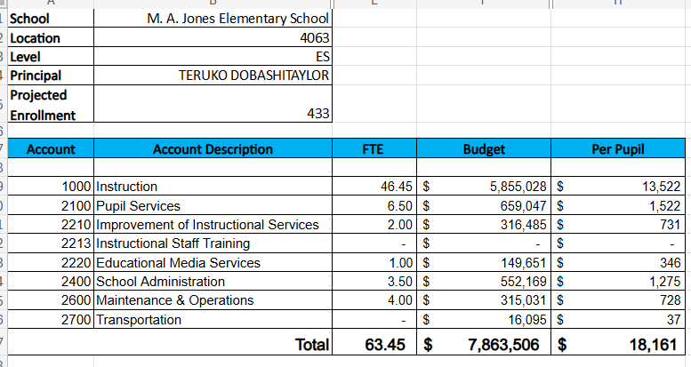
FY26 Budget by Function (required)
* Based on Current Allocation of School Budget

Slide 31
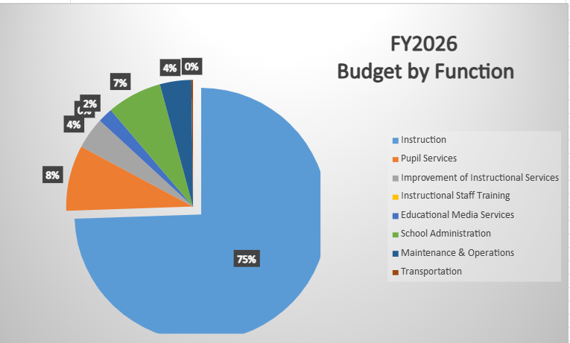
FY26 Budget by Function (required)
* Based on Current Allocation of School Budget

Slide 32
Questions for the GO Team to Consider and Discuss
Are our school’s priorities (from your strategic plan) reflected in this budget?
Are new positions and/or resources included in the budget to address our major priorities?
Do we know (as a team) the plan to support implementation of these priorities beyond the budget (ex. What strategies will be implemented)?
What tradeoffs are being made in order to support these priorities?
How are district and cluster priorities reflected in our budget?
Cluster priorities- what staff, materials, etc. are dedicated to supporting our cluster’s priorities?
Signature programs- what staff, materials, etc. are dedicated to supporting our signature program?
Are there positions our school will share with another school, i.e. nurse, counselor?

Slide 33
Discussion of Reserve & Holdback Funds

Slide 34
Plan for FY26 Leveling Reserve
$106,176
Priorities | Strategies | Requests | Amount
Data-Driven Instruction/ Targeted Instruction | Targeted interventions | Purchase (1) additional teacher tutor | $27, 720
Use Flexible learning tools & technology to target instruction | Technology Resources for personalized learning | Lexia, IXL, Reading A-Z, etc. | $50,000
STEAM Enriched Curriculum | Professional Learning | STEAM team to PBL world/ other STEAM PL | $28,456

Slide 35
Plan for FY26 Title I Holdback
$27,878
Priorities | Strategies | Requests | Amount
Data-Driven Instruction/ Targeted Instruction | Targeted interventions | Purchase (1) additional teacher tutor | $27, 720

Slide 36
Where We’re Going
Our next meeting is the Budget Approval Meeting
What:
During this meeting we will review the budget, which should be updated based on feedback from the staffing conference, Associate Superintendents, and key leaders. After review, GO Teams will need to take action (i.e., vote) on the FY25 Budget.
Why:
Principals will present the final budget recommendations for GO Team approval.
When:
All approval meetings must be held after staffing conferences. Budgets must be approved by March 15th.

Slide 37
What’s Next?
February
  Cluster Superintendent Review (February 17-21)
  HR Staffing Conferences (February 24– February 27)
March
  Final GO Team Approval Meeting (AFTER your school’s Staffing Conference and BEFORE Friday, March 14th)
    ACTION (i.e.- GO Team votes) on final budget recommendation before March 14

Slide 38
Thank you!

